Slide 1
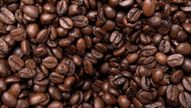
Where is the Best Coffee?

Slide 2
Business Problem
A business owner is looking to open up a coffee museum to pay tribute to coffee history. The owner would like to open the museum in the Mecca of coffee to ensure great coffee shops surround it. The owner has sought out multiple experts' opinions, but she has received numerous recommendations for the museum's local. The owner ultimately wants to open the museum where the best coffee is, and they would like to see how data can find this location. The only limitation the owner would like to limit is that the museum needs to be in the US, and they would like to open it in a major city.

Slide 3
Data Sources
To develop a dataset to answer this question, we will call the Foursquare API to collect data on coffee shops in the US's most populated cities. To achieve this, we will use a data set from https://simplemaps.com/data/us-cities, sorted by population, to call for coffee shops across the US, starting with the most populated cities. We will then analyze likes and rating data on these coffee shops to determine the city in which the best coffee shops are. Foursquare users contribute likes and ratings, so they should be a strong indicator of overall sentiment.

Slide 4
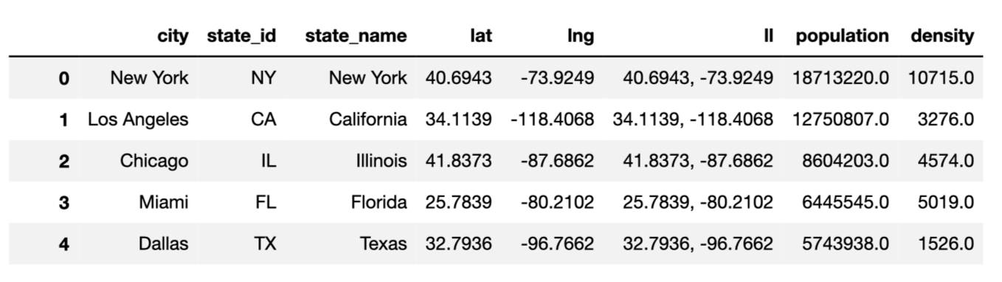
City Data
To start, We imported US city data from https://simplemaps.com/data/us-cities and sorted cities by population. The top 5 most populated cities in the US are Ney York, Los Angeles, Chicago, Miami, and Dallas.

Slide 5
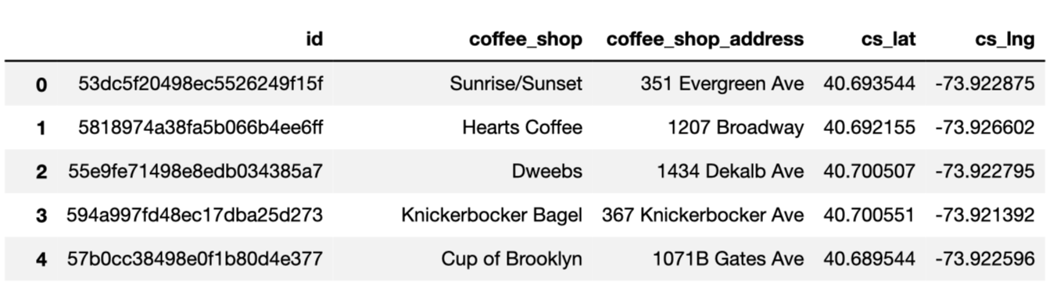
Coffee Shop Data
Once we had city data, we took this geographic data on the most populated cities in the US and called the Foursquare API to find coffee shops within a 1700 meter proximity to the 20 most populated cities.

Slide 6
Data Points for Analysis
We then retrieved Price tier, rating, and like counts data on the delivered dataset, removing shops that did not have data. Descriptors for these datapoints are below as well as the resulting dataset.
Price Tier: descriptor of priciness of coffee shops on a 1 - 3 scale.
Rating: overall rating of quality on a 1 – 10 scale.
Likes: number of likes visitors have given the coffee shop in Foursquare’s history.

Slide 7
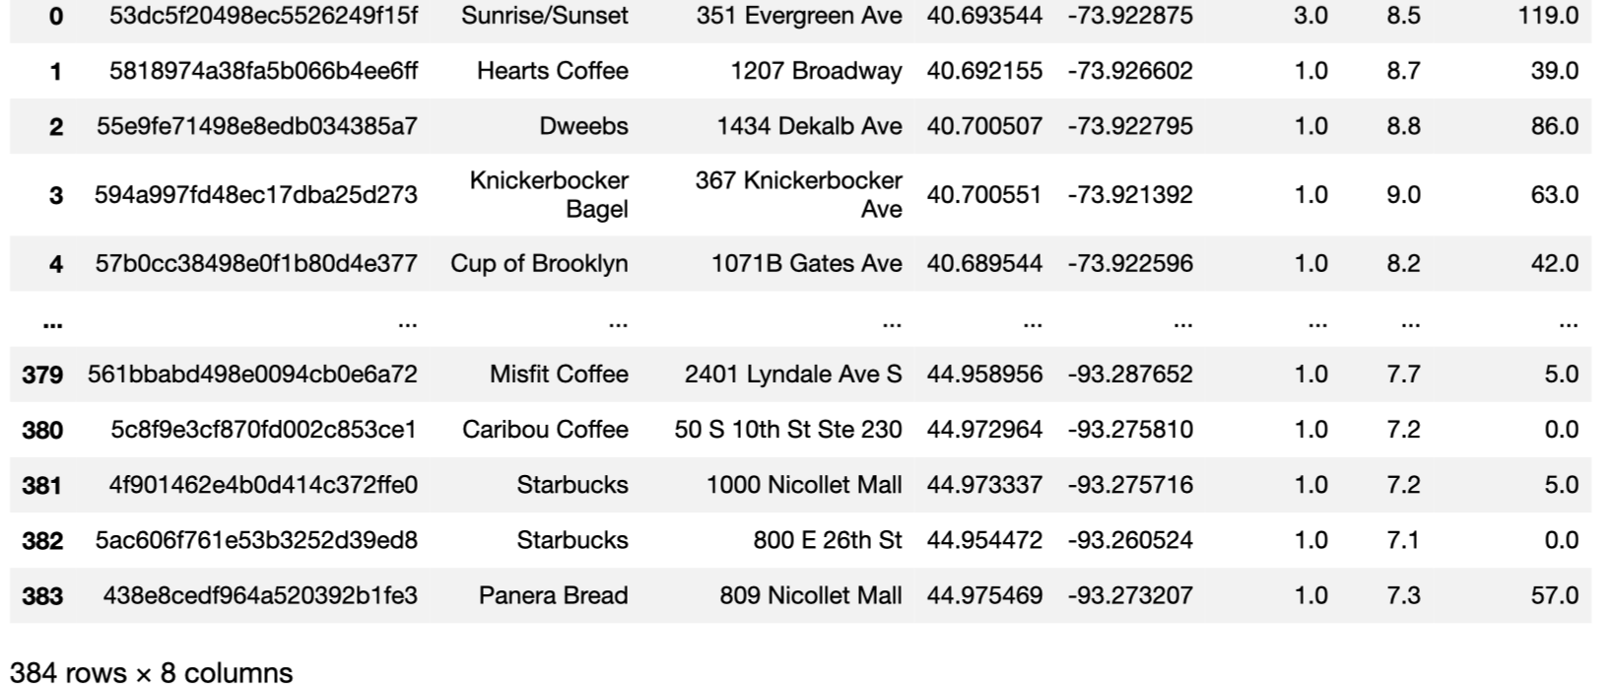
Final Data Set

Slide 8
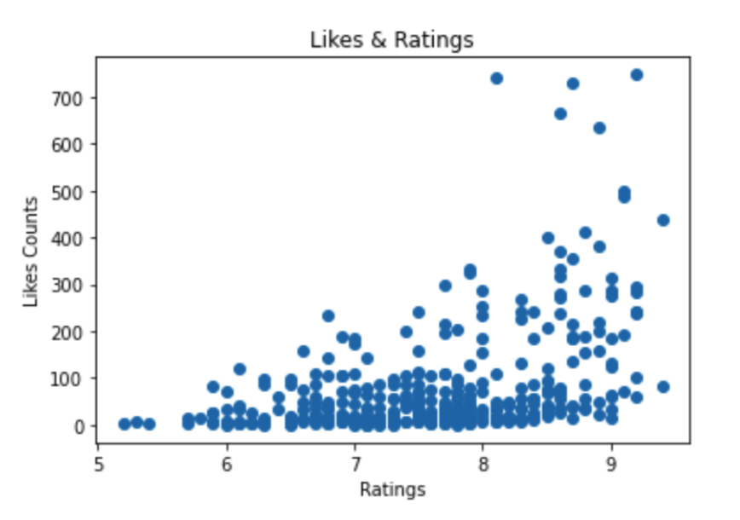
Ratings and Likes
From initial analysis, there appeared to be a loose linear correlation between likes and ratings. The highest rated coffee shops also had the most likes. Most coffee shops had less than 100 likes, with the highest rated ones have upwards of 700.

Slide 9
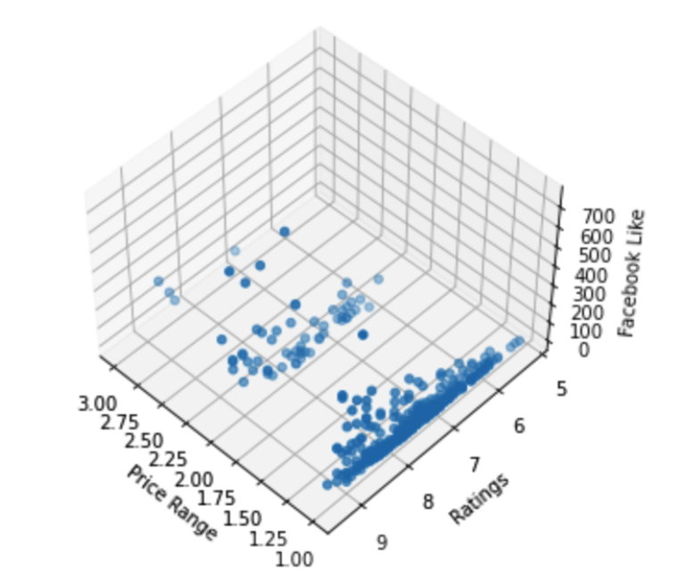
Ratings, Likes, and Price-Tiers
When brining price range into consideration, We found that the majority of coffee shops were low price, but there was no significant correlation between price and ratings. A level 3 price tier was not predictor of rating or likes.

Slide 10
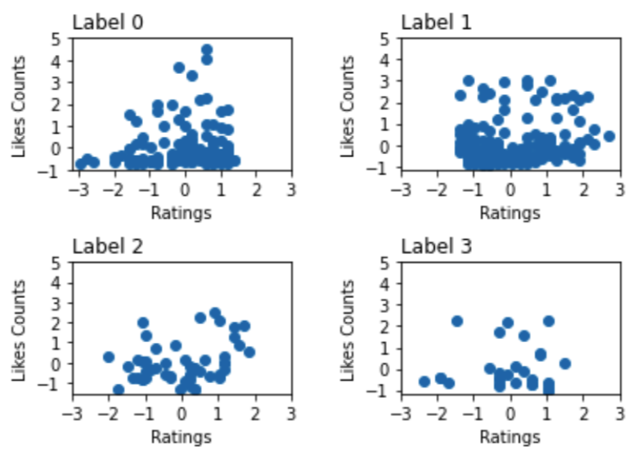
Clusters
Exploring the data using k-means, 4 clusters were identified across price tier, prating, and likes. Looking across clusters, the cluster labeled 1 showed the highest rated coffee shops at a medium price tier.

Slide 11
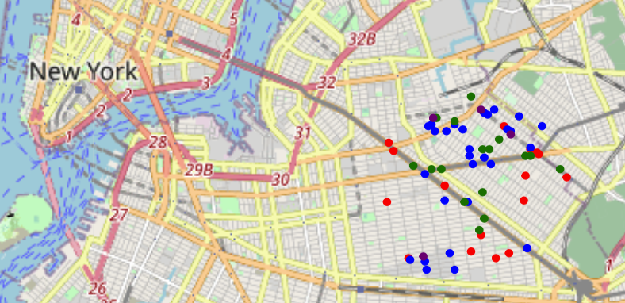
Results
The major city with the most coffee shops in cluster 1 was New York, followed by Washington and Chicago. This leads us to the recommendation that the best place to open the museum would be in New York on Myrtle Avenue.

